Slide 1

AWS CLOUD PRACTITIONER
The Cloudticians org 9TH GENERATION TRAINING
LOVE IS WHAT WE DO! DLO

Slide 2
WHAT AWS OFFERS
Low Ongoing Cost: pay-as-you-go pricing with no up-front expenses or long-term commitments.
Instant Elasticity & Flexible Capacity: (scaling up and down) Eliminate guessing on your infrastructure capacity needs.
Speed & Agility: Develop and deploy applications faster Instead of waiting weeks or months for hardware to arrive and get installed.
Apps not Ops: Focus on projects. Let's you shift resources away from data center investments and operations and move them to innovative new projects.
Global Reach: Take your apps global in minutes.
Open and Flexible: You choose the development platform or programming model that makes the most sense for your business.
Secure: This allows your application to take advantage of the multiple layers of operational and physical security in the AWS data centers to ensure the integrity and safety of your data.

Slide 3
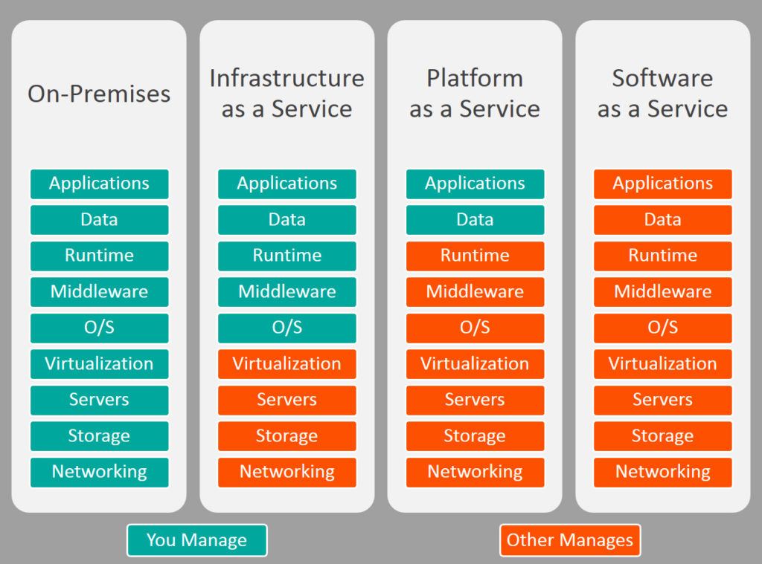
CLOUD MODELS

Slide 4
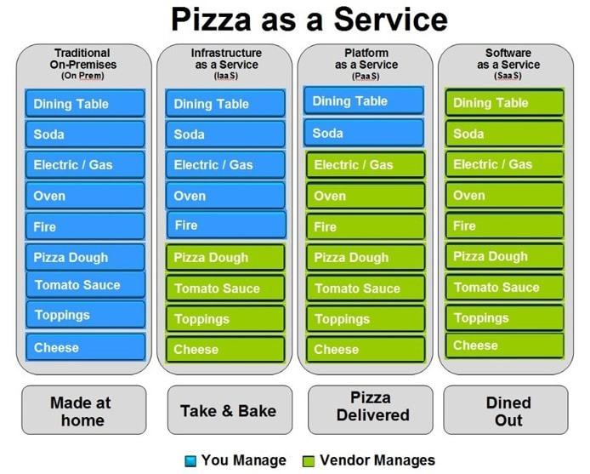
Think of it as…

Slide 5
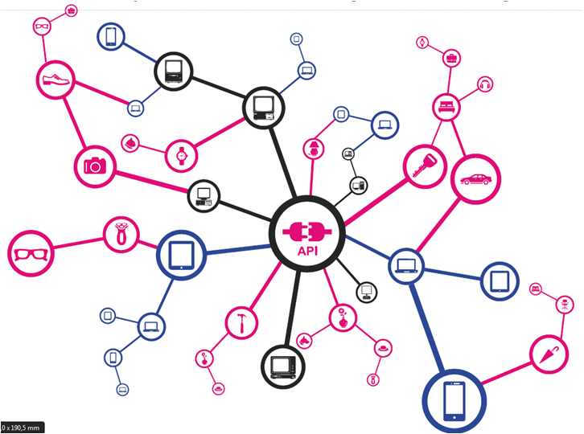
Terminology

Slide 6
Terminology
HIGH AVAILABILITY
refers to systems that are durable and likely to operate continuously without failure for a long time. for a solutions architect, this means making sure your application ( hosted in aws) is always available when a user/customer tries to access it.
FAULT TOLERANCE
is the property that enables a system to continue operating properly in the event of the failure of one or more of its components. A fault tolerant application (in AWS) is built so one of it's web servers can fail and still serve traffic to visitors (and ever repair itself).
ELASTICITY
the ability of a system to increase and decrease in size (usually based on usage demand). When architecting applications, this usually refers to the ability of an applications, this usually refers to the ability of an application to increase and decrease server capacity on demand.

Slide 7
Terminology
COST EFFICIENT
Choosing the correct options to make a system as inexpensive as possible.
SECURE
Following proper security guidelines and practices to secure a system.
AWS BEST PRACTICES
A set of guidelines outlined by AWS that should be followed when provisioning and using their services.
SCALABILITY
The ability of a system to easily increase in size and capacity in a cost-effective way (usually based on usage demand).
PRINCIPAL OF LEAST PRIVILEGE
Giving a user only the rights/access to the AWS services and resources they need to do their job (and nothing more)

Slide 8
SIMPLE STORAGE SERVICE (S3)
Amazon S3 has a simple web services interface that you can use to store and retrieve any amount of data, at any time, from anywhere on the web.
It gives any user access to the same highly scalable, reliable, fast, inexpensive data storage infrastructure that Amazon uses to run its own global network of websites. The service aims to maximize benefits of scale and to pass those benefits on to users."

Slide 9
S3 COMPONENTS AND STRUCTURES
Basics
(1) S3 Simple Storage Service
(2) It is AWS's primary storage service.
(3) You can store any type of file in S3.
Buckets
(1) Root level "Folders you create in S3 are referred to as buckets.
(2) Any subfolder you create in a bucket is referred to as a folder.

Slide 10
S3 COMPONENTS AND STRUCTURES
Objects
(1) Files stored in a bucket are referred to as objects
Regions
(1) When you create a bucket, you must select a specific region for it to exist in. This means that any data you upload to the S3 bucket will be physically located in a data center in that region
(2) Best practice is to select the region that is physically closest to you (to reduce transfer latency)
OR
(3) If you are serving files to a customer based in a certain area of the world, create the bucket in a region closest to your customers (to reduce latency for your customers)

Slide 11
S3 STROAGE CLASS
What is a storage class?
1) A storage class represents the "classification" assigned to each Object in S3.
Available storage classes include:
Standard
Standard-A (Infrequent Access)
One Zone-IA (Infrequent Access)
Intelligent-Tiering
Glacier
2) Each storage class has varying attributes that dictate things like:
Storage cost
Object availability
Object durability
Frequency of access (to the object)
3) Each object must be assigned a storage class ("'standard“ is the default class)
4) You can change the storage class of an object at any time (for the most
part)

Slide 12
S3 STORAGE CLASS
Standard
(1) Designed for general, all-purpose storage.
(2) Is the default storage option.
(3) 99.9999999999% object durability ("eleven nines").
(4) 99.99 object availability.
(5) Is the most expensive storage class.
Standard-IA (Infrequent Access)
(1) Designed for objects that you do not access frequently, but must be
immediately available when accessed. (uses multiple Availability Zones)
(2) 99.999999999% object durability
(3) 99.9 object availability
Standard-IA is less expensive than the standard storage class.

Slide 13
S3 STORAGE CLASS
One Zone-IA (infrequent Access)
(1) Designed for objects that you do not access frequently, but must be
immediately available when accessed. (only uses 1 Availability Zone)
(2) 99.999999999% object durability
(3) 99.5% object availability
(4) Is-20% less expensive than the standard-IA storage class
Intelligent-Tiering
(1) Designed to optimize costs by automatically moving data to the most
cost-effective tier based on your usage
(2) 99.999999999% object durability (eleven nines)
(3 99.9% object availability
(4) Pricing depends on the assigned storage class.

Slide 14
S3 STORAGE CLASS
S3 Glacier
(1) Amazon S3 enables you to utilize Amazon S3 Glacier’s extremely low-cost storage service for data archival.
(2) 99.999999999% object durability
(3) 99.5% object availability
S3 Glacier Deep Archive
(1) S3 Glacier Deep Archive is a new Amazon S3 storage class that provides secure and durable object storage for long-term retention of data that is accessed once or twice in a year
(2) 99.999999999% object durability (eleven nines)
(3 99.9% object availability
(4) Lowest cost storage class.

Slide 15
Virtual Private Cloud VPC
A VPC spans all the Availability Zones in the region. After creating a VPC, you can add one or more subnets in each Availability Zone.
01
VPC allows bridging with an onsite IT infrastructure with an encrypted VPN connection with an extra charge per VPN Connection-hour.
02
There is no additional charge for using Amazon Virtual Private Cloud, aside from the normal Amazon EC2 usage charges.
03

Slide 16
Subnets
A subnet, shorthand for subnetwork, is a sub-section of a network. Generally, a subnet includes all of the computers in a specific location.

Slide 17
Subnet
Specify the CIDR block for the subnet, which is a subset of the VPC CIDR block.
1
Each subnet must reside entirely within one Availability Zone and cannot span zones.
2
Assign a unique tag to each subnet.
3

Slide 18
SUBNETS ROUTING
Each subnet must be associated with a route table, which specifies the allowed routes for outbound traffic leaving the subnet.
Every subnet that you create is automatically associated with the main route table for the VPC. You can change the association, and you can change the contents of the main route table.

Slide 19
NETWORK SECURITY
SECURITY GROUPS - Control inbound and outbound traffic for your instances .acts as a virtual firewall for your instance to control inbound and outbound traffic. When you launch an instance in a VPC, you can assign up to five security groups to the instance. This is the firewall/security layer on the instance/server level
NACLs (Network Access Control Lists control) - Inbound and outbound traffic for your subnets. This is the firewall/security layer on the subnet level.

Slide 20
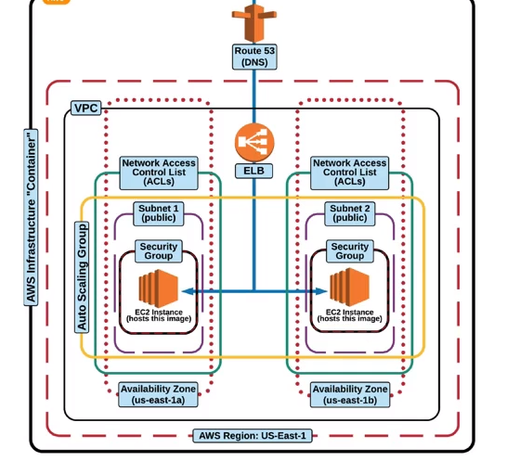
VIRTUAL PRIVATE CLOUD (VPC)

Slide 21
IAM - Identity Access Management
AWS IAM is a web service that helps you securely control access to AWS resources. You can use IAM to control who is authenticated (signed in) and authorized (has permissions) to use resources.
Shared access to your AWS account
You can grant other people permission to administer and use resources in your AWS account without having to share your password or access key.
Granular permissions
You can grant different permissions to different people for different resources. For example, you might allow some users complete access to Amazon Elastic Compute Cloud (Amazon EC2), Amazon Simple Storage Service (Amazon S3), Amazon DynamoDB, Amazon Redshift, and other AWS services. For other users, you can allow read-only access to just some S3 buckets, or permission to administer just some EC2 instances, or to access your billing information but nothing else.
Free to use
AWS Identity and Access Management (IAM) and AWS Security Token Service (AWS STS) are features of your AWS account offered at no additional charge. You are charged only when you access other AWS services using your IAM users or AWS STS temporary security credentials.

Slide 22
IAM - Identity Access Management
Secure access to AWS resources for applications that run on Amazon EC2
You can use IAM features to securely provide credentials for applications that run on EC2 instances. These credentials provide permissions for your application to access other AWS resources. Examples include S3 buckets and DynamoDB tables.
Multi-factor authentication (MFA)
You can add two-factor authentication to your account and to individual users for extra security. With MFA you or your users must provide not only a password or access key to work with your account, but also a code from a specially configured device.
API Keys for programmatic (CLI) Access : These are special credentials required for accessing AWS resources via the command line interface (CLI).
Identity federation
You can allow users who already have passwords elsewhere—for example, in your corporate network or with an internet identity provider—to get temporary access to your AWS account. This is a way of authenticating users using a third part provider e.g. exam Facebook
Identity information for assurance
If you use AWS CloudTrail, you receive log records that include information about those who made requests for resources in your account. That information is based on IAM identities.
PCI DSS Compliance
IAM supports the processing, storage, and transmission of credit card data by a merchant or service provider and has been validated as being compliant with Payment Card Industry (PCI) Data Security Standard (DSS).

Slide 23
IAM COMPONENTS
User
An AWS Identity and Access Management (IAM) user is an entity that you create in AWS to represent the person or application that uses it to interact with AWS. A user in AWS consists of a name and credentials.
Groups
An IAM group is a collection of IAM users. Groups let you specify permissions for multiple users, which can make it easier to manage the permissions for those users. For example, you could have a group called Admins and give that group the types of permissions that administrators typically need. Any user in that group automatically has the permissions that are assigned to the group.
Role
A role is intended to be assumable by anyone who needs it. Also, a role does not have standard long-term credentials such as a password or access keys associated with it. Instead, when you assume a role, it provides you with temporary security credentials for your role session.
Temporary Security Credentials
You can use the AWS Security Token Service (AWS STS) to create and provide trusted users with temporary security credentials that can control access to your AWS resources.
Principle of least Privilege: Giving a user only the rights/access to the AWS services and resources they need to do their job and nothing more.

Slide 24

EC2 –Elastic Compute Cloud
Think of EC2 as your basic desktop computer.
Amazon Elastic Compute Cloud (Amazon EC2) provides scalable computing
capacity in the Amazon Web Services (AWS) cloud. Using Amazon EC2
eliminates your need to invest in hardware up front so you can develop and
deploy applications faster. You can use Amazon EC2 to launch as many or as
few virtual servers as you need, configure security and networking, and manage
storage. Amazon EC2 enables you to scale up or down to handle changes in
requirements or spikes in popularity, reducing your need to forecast traffic."

Slide 25
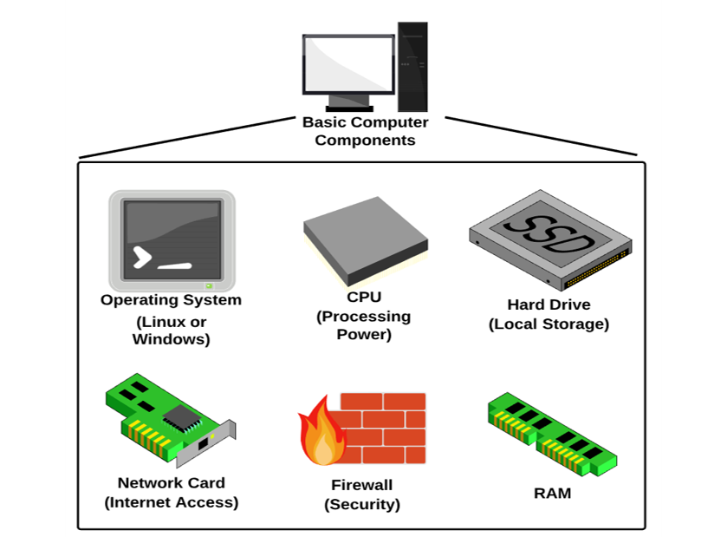
Amazon Machine Image
An Amazon Machine Image (AMI) is a master image for the creation of virtual servers (known as EC2 instances) in the Amazon Web Services (AWS) environment. The machine images are like templates that are configured with an operating system and other software, which determine the user's operating environment.
Cloud girls call it “Army”

Slide 26
Amazon Machine Image
AMI Options:
AMIs come in three main categories:
1) Community AMIs:
-Free to use
-Generally, with these AMIs you are just selecting the OS you want
(2) AWS Marketplace AMIs:
-Pay to use
-Generally comes packaged with additional, licensed software.
(3) My AMis:
-AMIs that you create yourself
Instance Type Options:
(1) General purpose instances
(2) Compute optimized instances
(3) GPU optimized
(4) Memory optimized instances
(5) Storage optimized instances
(6) High Memory instances

Slide 27
EC2 Pricing
EC2 Basics (buying options):
On-Demand:
On-demand purchasing allows you to choose any instance type you like and provision/terminate it at any time (on-demand).
(1) Is the most expensive purchasing option.
(2) Is the most flexible purchasing option.
(3) You are only charged when the instance is running (and billed by the second)
(4) You can provision/terminate an on-demand instance at any time.
Reserved:
Reserved purchasing allows you to purchase an instance for a set time period of one (1) or three (3)) years.
(1) This allows for a significant price discount over using on-demand.
(2) You can select to pay upfront, partial upfront, no upfront.
3) Once you buy a reserved instance, you own it for the selected time period and are responsible for the entire price regardless of how often you use them.

Slide 28
EC2 Pricing
EC2 Basics (buying options):
Spot:
Spot pricing is a way for you to "bid'" on an instance type and only pay for and use that instance when the spot price is equal to or below your "bid" price
1) This option allows Amazon to sell the use of unused instances, for short amounts of time, at a substantial discount
(2) Spot prices fluctuate based on supply and demand in the spot marketplace
(3) You are charged by the second (but bid pricing based on and hourly rate)
(4) When you have an active bid, an instance is provisioned for you when the spot price is equal to or less than you bid price.
5) Provisioned instances automatically terminate when the spot price is greater than your bid price.

Slide 29
Amazon Elastic Block Store (EBS)
Provides block level storage volumes (1 GB to 1 TB ) for use with Amazon EC2 instances. Multiple volumes can be mounted to the same instance.
EBS volumes are network-attached and persist independently from the life of an instance.
Storage volumes behave like raw, unformatted block devices, allowing users to create a file system on top of Amazon EBS volumes, or use them in any other way you would use a block device (like a hard drive).
EBS volumes are placed in a specific Availability Zone and can then be attached to instances also in that same Availability Zone.
Each storage volume is automatically replicated within the same Availability Zone. EBS provides the ability to create point-in-time snapshots of volumes, which are persisted to Amazon S3.
These snapshots can be used as the starting point for new Amazon EBS volumes, and protect data for long-term durability. The same snapshot can be used to instantiate as many volumes as you wish. These snapshots can be copied across AWS regions.

Slide 30
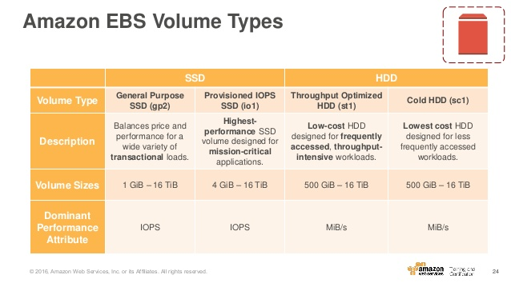
Elastic Block Store (EBS) -Volume
To enable your EC2 instances to fully utilize the IOPS provisioned on an EBS volume,:
Launch selected Amazon EC2 instance types as “EBS-Optimized” instances.
EBS-optimized instances deliver dedicated throughput between Amazon EC2 and Amazon EBS, with options between 500 Mbps and 1000 Mbps depending on the instance type used.
EBS charges based on per GB-month AND per 1 million I/O requests

Slide 31

AWS LAMBDA
Lambda is serverless computing. It is the next generation of cloud computing that will replace EC2 instances (for the most part).
AWS Lambda is a compute service that lets you run code without provisioning or managing servers. AWS Lambda executes your code only when needed and scales automatically, from a few requests per day to thousands per second.
You pay only for the compute time you consume there is no charge when your code is not running.

Slide 32
AWS LAMBDA
With AWS Lambda, you can run code for virtually any type of application or backend service all with zero administration.
AWS Lambda runs your code on a high-availability compute infrastructure and performs all of the administration of the compute resources, including server and operating system maintenance, capacity provisioning and automatic scaling, code monitoring and logging.
All you need to do is supply your code in one of the languages that AWS Lambda supports (currently Node.is, Java, C# and Python)."

Slide 33
Benefits & Use Cases of Lambda:
Additional Benefits:
(1) No servers to manage
(2) Continuous scaling
(4) Subsecond Metering
(3) Integrates with almost all other AWS services
Primary User Cases:
(1) Data Processing
(2) Real-time file processing
(3) Real-time stream processing
(4) Build serverless backends for web, mobile, IOT, and 3rd party API request

Slide 34
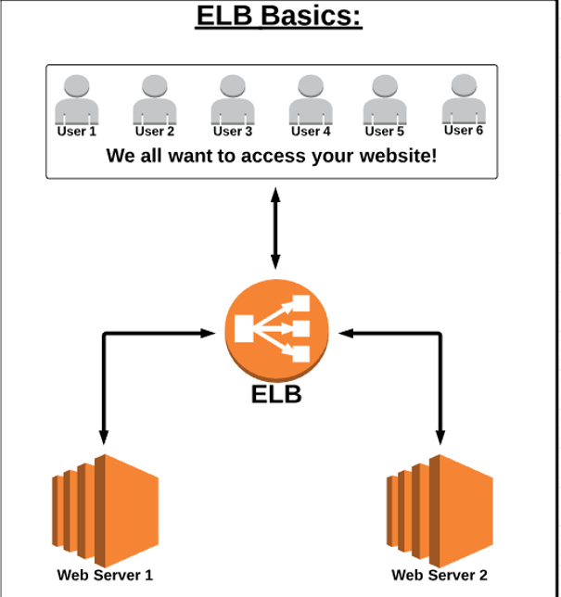
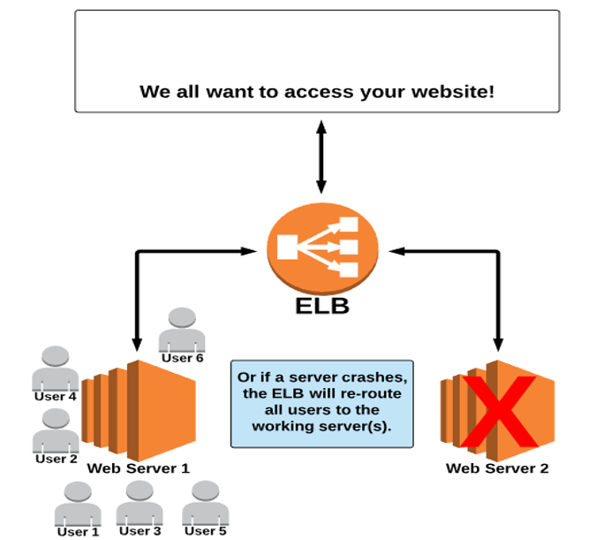
ELB - Elastic Load Balancing
An ELB evenly distributes traffic between EC2 instances that are associated with it.
A load balancer distributes incoming application traffic across multiple EC2 instances in multiple Availability Zones. This increases the fault tolerance of your applications.
Elastic Load Balancing detects unhealthy instances and routes traffic only to healthy instances.

Slide 35
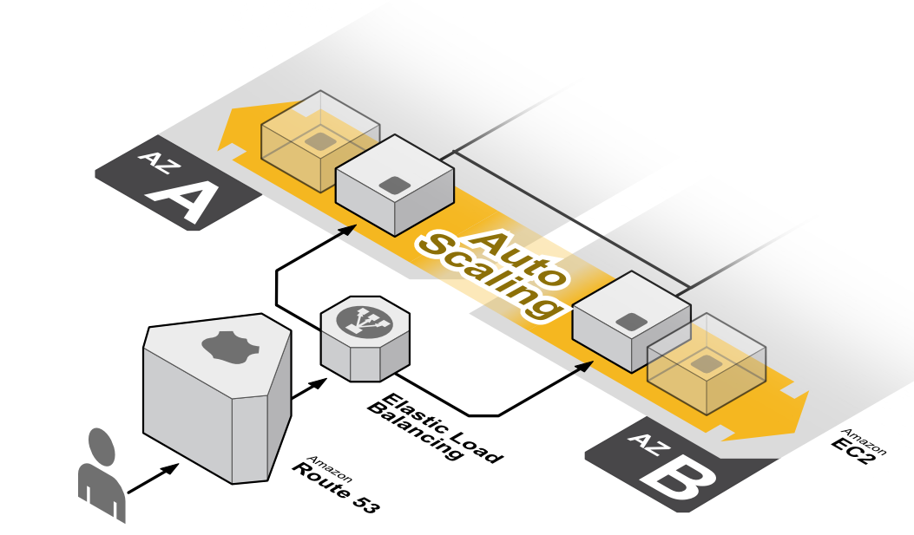
Auto Scaling
Auto Scaling automates the process of adding (scaling up) OR removing (scaling down) EC2 instances based on traffic demand for your application.
Auto Scaling helps you ensure that you have the correct number of Amazon EC2 instances available to handle the load for your application. You create collections of EC2 instances, called Auto Scaling groups. You can specify the minimum number of instances in each Auto Scaling group, and Auto Scaling ensures that your group never goes below this size. You can specify the maximum number of instances in each Auto Scaling group, and Auto Scaling ensures that your group never goes above this size.
If you specify the desired capacity, either when you create the group or at any time thereafter, Auto Scaling ensures that your group has this many instances. If you specify scaling policies, then Auto Scaling can launch or terminate instances as demand on your application increases or decreases

Slide 36
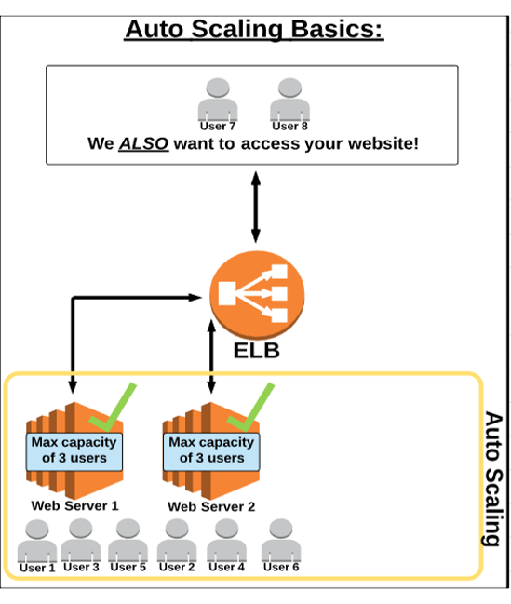
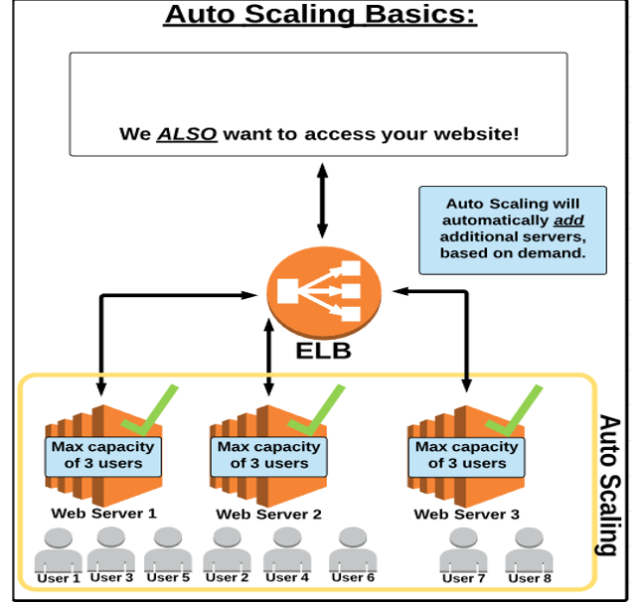
AUTO SCALING

Slide 37
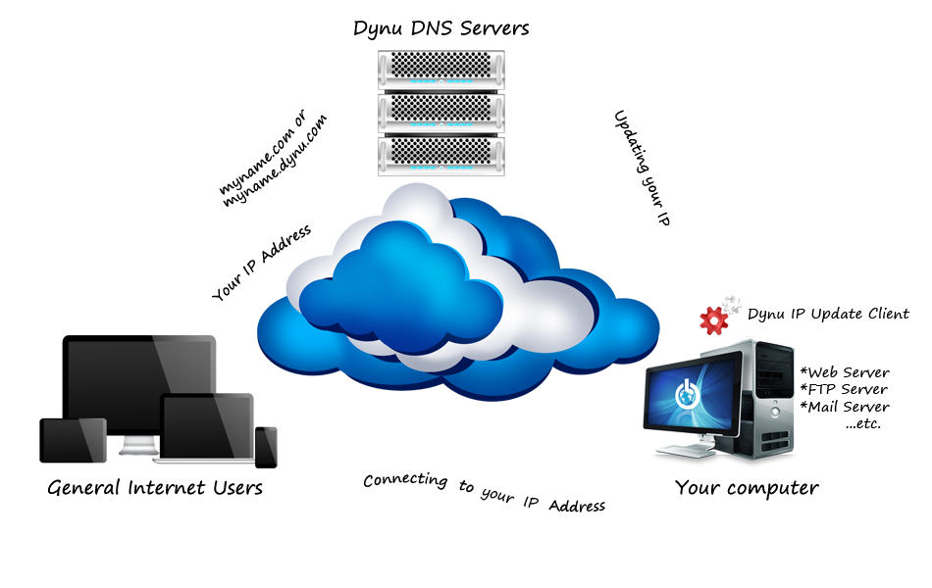
Route 53
Route 53 is where you configure and manage web domains for websites or applications you host on AWS.
"Amazon Route 53 performs three main functions Domain registration Amazon Route 53 lets you register domain names such as example.com.
Domain Name System (DNS) service Amazon Route 53 translates friendly domains names like www.example.com into IP addresses like 192.0.2.1. Amazon Route 53 responds to DNS queries using a global network of authoritative DNS servers, which reduces latency.
Health checking Amazon Route 53 sends automated requests over the Internet to your application to verify that it's reachable, available, and functional. You can use any combination of these functions. For example, you can use Amazon Route 53 as both your registrar and your DNS service, or you can use Amazon Route 53 as the DNS service for a domain that you registered with another domain registrar.

Slide 38

CloudFront
CloudFront is a Content Delivery Network (CDN) that allowS you to store (cache) your content at "edge locations" located all around the world. This allows your Customers to access your content more quickly (and also provides additional security especially against DDOS attacks).
Amazon CloudFront is a global content delivery network (CDN) service that securely delivers data, videos, applications, and APls to your viewers with low latency and high transfer speeds. CloudFront is integrated with AWS – both physical locations that are directly connected to the AWS global infrastructure, as well as software that works seamlessly with senvices including AWS Shield for DDOS mitigation;Amazon S3, Elastic Load Balancing or Amazon Ec2 as origins for your applications, and AWS Lambda to run custom code close to your viewers.

Slide 39
Benefit of Route 53 & CloudFront
Route 53:
(1) Domain registration (Like Godaddy.com, Namecheap.com).
(2) Domain Name System (DNS) service
(3) Traffic Flow (send users to the best endpoint)
(4) Health checking
(5) DNS Failover (Automatically change domain endpoint if system fails)
(6) Integrates with ELB, S3, and CloudFront as endpoints
CloudFront:
(1) Cache content at Edge Locations for fast distribution to customers
(2) Built-in Dedicated Denial of Service (DDOS) attack protection
(3) Integrates with many AWS services (S3, EC2, ELB, Route 53, Lambda)

Slide 40

AWS CloudWatch
CloudWatch is a service that allows you to monitor various elements of your AWS account.
Amazon CloudWatch monitors your Amazon Web Services (AWS) resources and the applications you run on AWS in real time. You can use CloudWatch to collect and track metrics, which are variables you can measure for your resources and applications.
CloudWatch alarms send notifications or automatically make changes to the resources you are monitoring based on rules that you define."

Slide 41
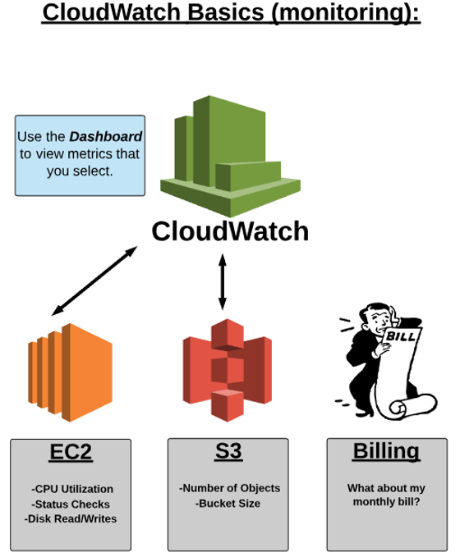
Benefits of CloudWatch
(1) Monitor metrics for almost all your AWS resources (i.e. EC2 instances)
(2) Create and monitor custom metrics
(3) Create custom dashboards for easy viewing of metrics
(4) Monitor and store logs
(5) Set alarms and events (and trigger actions based on then

Slide 42
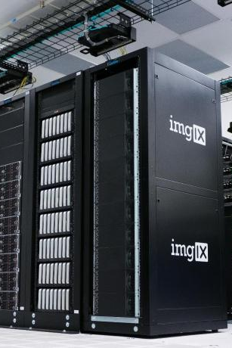
AWS CloudTrail
CloudTrail allows you to monitor all actions taken by IAM users (i.e. services accessed and actions taken -such as logging who deleted an S3 object).
AWS CloudTrail is a service that enables governance, compliance, operational auditing, and risk auditing of your AWS account. With CloudTrail, you can log, continuously monitor, and retain account activity related to actions across your AWS infrastructure.
CloudTrail provides event history of your AWS account activity, including actions taken through the AWS Management Console, AWS SDKs, command line tools, and other AWS services. This event history simplifies security analysis, resource change tracking, and troubleshooting.

Slide 43

AWS SNS -Simple Notification Service
An AWS service that allows you to automate the sending of email or text message notifications, based on events that happen in your AWS account.
Simple Notification Service is a web service that coordinates and manages the delivery or sending of messages to subscribing endpoints or clients. In Amazon SNS, there are two types of clients-publishers and subscribers –also referred to as producers and consumers.
Publishers communicate asynchronously with subscribers by producing and sending a message to a topic, which is a logical access point and communication channel. Subscribers (i.e. web servers, email addresses, Amazon SQS queues, AWS Lambda functions) consume or receive the message or notification over one of the supported protocols (i.e., Amazon SQS, HTTP/S, email, SMS, Lambda) when they are subscribed to the topic.

Slide 44
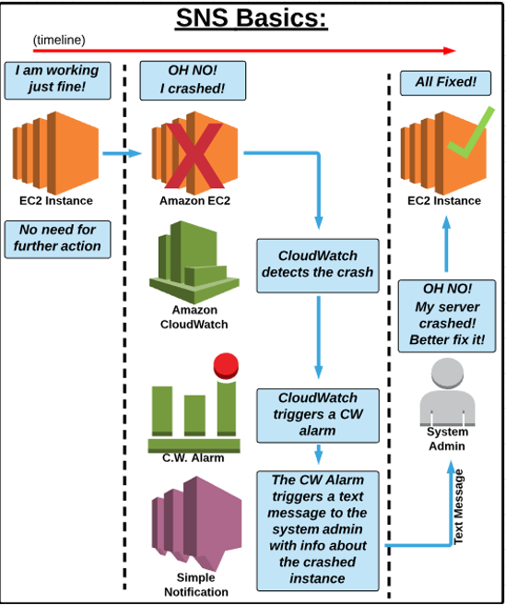
SNS Benefits
Simple Notification Service (SNS):
(1) Send automated or manual notifications.
(2) Send notification to email, mobile (sms), and HTTP endpoints.
(3) Closely integrated with other AWS service (such as CloudWatch) so that alarms, events, and actions in your AWS can trigger notifications.

Slide 45

AWS Primary Database Options
In the world of databases, there are two main categories:
(1) Relational Databases known as "SQL"
(2) Non-Relational Databases known as "NoSQL"
Amazon offers Managed services for both types of databases : RDS for SQL databases and DynamoDB for NoSQL databases

Slide 46

SQL Databases
In relational databases (SQL Databases), ACID (Atomicity, Consistency, Isolation, Durability) is a set of properties that guarantee that database transactions are processed reliably.
Atomicity requires that each transaction is "all or nothing": if one part of the transaction fails, the entire transaction fails, and the database state is left unchanged.
The consistency property ensures that any transaction will bring the database from one valid state to another.
The isolation property ensures that the concurrent execution of transactions results in a system state that would be obtained if transactions were executed serially.
Durability means that once a transaction has been committed, it will remain so, even in the event of power loss, crashes, or errors.

Slide 47
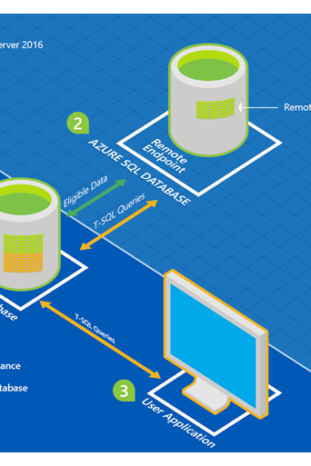
Relational Database Service (RDS)
Relational Database Service (RDS) is a SQL database service that provides a wide range of SQL database options to select from.
SQL Options Include:
(1) Amazon Aurora
(2) MysQL
(3) MariaDB
(4) PostgreSQL
(5) Oracle (several Oracle options are available)
(6) Microsoft SQLServer (several Microsoft options are available)
Amazon Relational Database Service (Amazon RDS) is a web service that makes it easier to set up, operate, and scale a relational database in the cloud. It provides cost-efficient, resizeable capacity while automating time-consuming administration tasks such as hardware provisioning, database setup, patching and backups. It frees you to focus on your applications so you can give them the fast performance, high availability, security and compatibility they need.

Slide 48
NoSQL Database
A NoSQL database provides a mechanism for storage and retrieval of data that employs less constrained consistency models than traditional relational databases.
NoSQL databases only support Eventual Consistency which is a consistency model used in distributed computing that informally guarantees that, if no new updates are made to a given data item, eventually all accesses to that item will return the last updated value.
NoSQL databases are often highly optimized key–value stores intended for simple retrieval and appending operations, with the goal being significant performance benefits in terms of latency and throughput.
Key–value stores allow the application to store its data in a schema-less way.
The data could be stored in a datatype of a programming language or an object. Because of this, there is no need for a fixed data model.

Slide 49
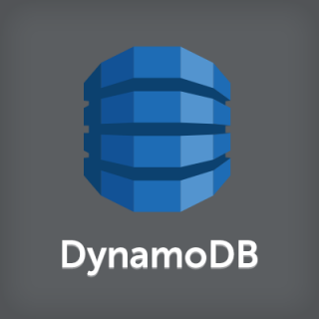
AWS DynamoDB
DynamoDB is a fast, fully managed NoSQL database service that makes it simple and cost-effective to store and retrieve any amount of data, and serve any level of request traffic.
All data items are stored on Solid State Drives (SSDs), and are replicated across 3 Availability Zones for high availability and durability.
DynamoDB tables do not have fixed schemas, and each item may have a different number of attributes.
DynamoDB has no upfront costs and implements a pay as you go plan as a. a flat hourly rate based on the capacity reserved.

Slide 50
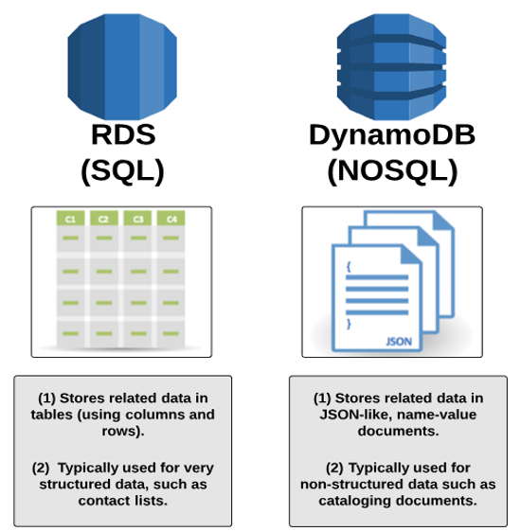
What's the difference
RDS
(1) For when you need a SQL database option.
(2) Easy to set up, highly available, fault-tolerant, and scalable
(3) Used when data is clearly defined.
4) Common use case include online stores and banking systems.
DynamoDB
(1) For when you need a NoSQL database option
(2) Fast, highly Scalable, and fully-managed
(3) Used when data is fluid and can change.
(4) Common use cases include social networks, web analytics

Slide 51

Amazon ElastiCache
ElastiCache is a data caching service used to help improve speed/performance of web applications running on AWS.
Amazon ElastiCache is a web service that makes it easy to deploy, operate, and scale an in-memory data store or cache in the cloud. The service improves the performance of web applications by allowing you to retrieve information from fast, managed, secure in-memory data stores, instead of relying entirely on slower disk-based databases.
Amazon ElastiCache supports two open-source in-memory engines:
Redis: A fast, open source, in-memory data store and cache.
MemcacheD: a widely adopted memory object caching system.

Slide 52
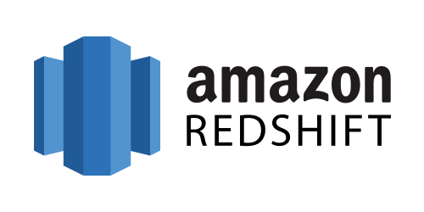
AWS Redshift
Redshift is a data warehouse database service designed to handle petabytes of data for analysis.
Amazon Redshift is a fast, fully managed data warehouse that makes it simple and cost-effective to analyze all your data using standard SQL and your existing Business Intelligence (BI) tools. It allows you to run complex analytic queries against petabytes of structured data, using sophisticated query optimization, columnar storage on high-performance local disks, and massively parallel query execution.

Slide 53

AWS Organizations
AWS Organizations helps you centrally govern your environment as you grow and scale your workloads on AWS. Whether you are a growing startup or a large enterprise, Organizations helps you to centrally manage billing; control access, compliance, and security; and share resources across your AWS accounts.
Using AWS Organizations, you can automate account creation, create groups of accounts to reflect your business needs, and apply policies for these groups for governance. You can also simplify billing by setting up a single payment method for all of your AWS accounts, this is possible through Consolidated billing.
Through integrations with other AWS services, you can use Organizations to define central configurations and resource sharing across accounts in your organization. AWS Organizations is available to all AWS customers at no additional charge.

Slide 54

Amazon Elastic MapReduce (EMR)
Amazon EMR is a web service that makes it easy to quickly and cost-effectively process vast amounts of data using Hadoop.
Amazon EMR distribute the data and processing across a resizable cluster of Amazon EC2 instances.
With Amazon EMR you can launch a persistent cluster that stays up indefinitely or a temporary cluster that terminates after the analysis is complete.
Amazon EMR supports a variety of Amazon EC2 instance types and Amazon EC2 pricing options (On-Demand, Reserved, and Spot).
When launching an Amazon EMR cluster (also called a "job flow"), you choose how many and what type of Amazon EC2 Instances to provision.
The Amazon EMR price is in addition to the Amazon EC2 price.
Amazon EMR is used in a variety of applications, including log analysis, web indexing, data warehousing, machine learning, financial analysis, scientific simulation, and bioinformatics.

Slide 55

AWS Elastic Beanstalk
AWS Elastic Beanstalk provides a solution to quickly deploy and manage applications in the AWS cloud.
You simply upload your application, and Elastic Beanstalk automatically handles the deployment details of capacity provisioning, load balancing, auto-scaling, and application health monitoring.
Elastic Beanstalk leverages AWS services such as Amazon EC2, Amazon S3, ….
To ensure easy portability of your application, Elastic Beanstalk is built using familiar software stacks such as:
Apache HTTP Server for Node.js, PHP and Python
Passenger for Ruby,
IIS 7.5 for .NET
Apache Tomcat for Java.
There is no additional charge for Elastic Beanstalk - you pay only for the AWS resources needed to store and run your applications.

Slide 56
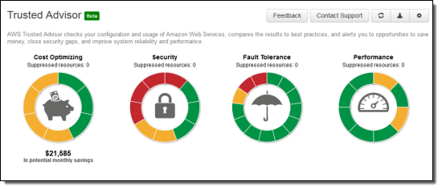
AWS Trusted Advisor
AWS Trusted Advisor is a service that "advises" and helps you optimize aspects of your AWS account.
An online resource to help you reduce cost, increase performance, and improve security by optimizing your AWS environment, Trusted Advisor provides real-time guidance to help you provision your resources following AWS best practices.
Trusted Advisor Categories:
(1) Cost Optimization
(2) Performance
(3) Security
(4) Fault Tolerance

Slide 57

AWS Pricing Principals
(1) AWS works on a pay-as-you-go model. Meaning that you only pay for what you use, when you are using it. There are no upfront cost, and charges immediately end when you stop using a particular service or feature (for the most part)
(2) No long term contracts or complex licensing are required.
Exceptions can be something like reserved EC2 instances. (not required)
(3) Volume discounts are available. So the more you use a service, the cheaper it can get (per unit used).
(4) There are no termination fees.

Slide 58
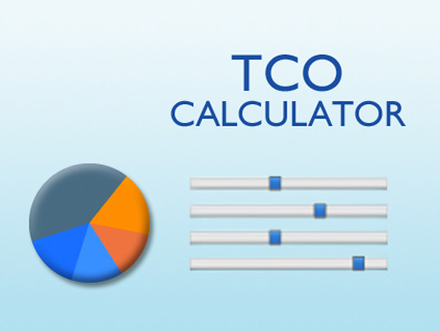
Total Cost of Ownership (TCO) Calculator
(1) The TCO calculator is free tool provided by AWS that allows you to estimate the cost savings of using the AWS Cloud vs. using an on-premises data center.
(2) By showing you how much you can save by using AWS, the calculator helps you reduce the Total Cost of Ownership (TCO) by avoiding large capital expenditures on l.T. hardware and infrastructure
(3) The TCO Calculator can also provide directional guidance on cost savings.
(4) The TCO Calculator works by you inputting elements of your current/or theoretical on-premises data center, and comparing those cost requirements to how much it would cost in AWS.
(5) Elements can be added/modified as you move through the process to best estimate the cost savings.

Slide 59
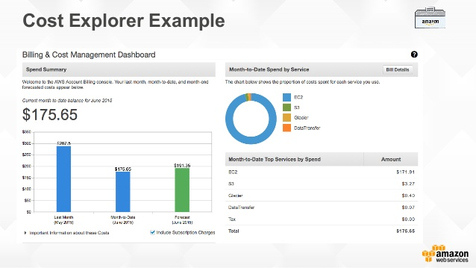
Cost Explorer
(1) The Cost Explorer is a free tool that allows you to view charts of your costs.
(2) View Cost data for the past 13 months.
(3) Forecast how much you are likely to spend over the next three months.
(4) Use the explorer to discover patterns in how much you spend on AWS resources over time and identify (cost) problem areas
(5) Identify which services you use the most, and/or metrics like which Availability Zones has the most traffic, or which linked AWS account is used the most.

